Slide 1

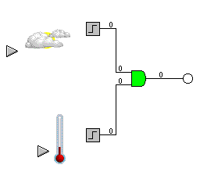
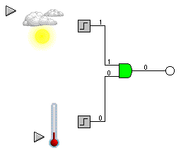
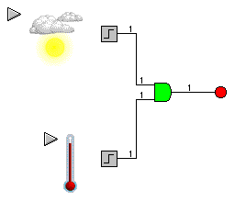
LOGIC GATES
Logic generally has only 2 states, ON or OFF, represented by 1 or 0. Logic gates react to inputs in certain ways.
The AND gate will only switch on its output Q, if Input A is ON and Input B is ON. This can be shown in a Truth Table, 0=OFF and 1=ON.
A | B | Q
0 | 0 | 0
0 | 1 | 0
1 | 0 | 0
1 | 1 | 1
INPUT A
OUTPUT Q
INPUT B
Symbol for AND gate
Logic can be used to control devices according to certain conditions, such as “switch on a fan if it’s hot AND the sun is out”. Look at the diagrams below.
If both inputs are OFF the output is OFF
Even if one input is ON the output is OFF
Only if A =1 and B =1 will the output switch on

Slide 2





MORE LOGIC GATES
Try and work out the truth tables for these gates. The rule will help you.
AND
OR
XOR
A
A
A
Q
Q
Q
B
B
B
RULE: Q = 1 if A AND B =1
RULE: Q = 1 if A OR B =1
Q = 1 if A OR B =1, but NOT both
A | B | Q
0 | 0
0 | 1
1 | 0
1 | 1
A | B | Q
0 | 0
0 | 1
1 | 0
1 | 1
A | B | Q
0 | 0
0 | 1
1 | 0
1 | 1
NAND
NOR
NOT
A
A
Q
Q
A
Q
B
B
RULE: Q = 0 if A AND B =1
RULE: Q = 0 if A OR B =1
RULE: Q = 0 if A =1
A | B | Q
0 | 0
0 | 1
1 | 0
1 | 1
A | B | Q
0 | 0
0 | 1
1 | 0
1 | 1
A | Q
0
1

Slide 3
LOGIC GATES
AND
OR
XOR
A
A
A
Q
Q
Q
B
B
B
RULE: Q = 1 if A AND B =1
RULE: Q = 1 if A OR B =1
Q = 1 if A OR B =1, but NOT both
A | B | Q
0 | 0 | 0
0 | 1 | 0
1 | 0 | 0
1 | 1 | 1
A | B | Q
0 | 0 | 0
0 | 1 | 1
1 | 0 | 1
1 | 1 | 1
A | B | Q
0 | 0 | 0
0 | 1 | 1
1 | 0 | 1
1 | 1 | 0
NAND
NOR
NOT
A
A
Q
Q
A
Q
B
B
RULE: Q = 0 if A AND B =1
RULE: Q = 0 if A OR B =1
RULE: Q = 0 if A =1
A | B | Q
0 | 0 | 1
0 | 1 | 1
1 | 0 | 1
1 | 1 | 0
A | B | Q
0 | 0 | 1
0 | 1 | 0
1 | 0 | 0
1 | 1 | 0
A | Q
0 | 1
1 | 0

